Slide 2
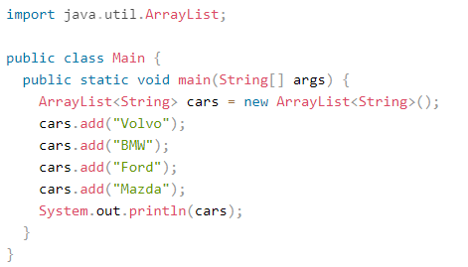
Arraylist
Arraylist is a resizable array (array’s length is fixed and can’t be resized )
Example :

Slide 3
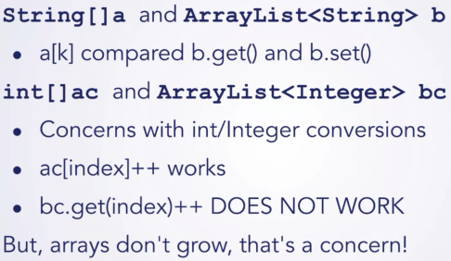
Array vs arraylist

